Slide 1
L10n and I18n
Mark Lin

Slide 2
Wat is i18n?
i18n: internationalization
Make an application international; that is, make it able to support virtually any language or local setting on Earth without modify source code. https://wiki.mageia.org/en/What_is_i18n,_what_is_l10n
A single application for ALL country

Slide 3
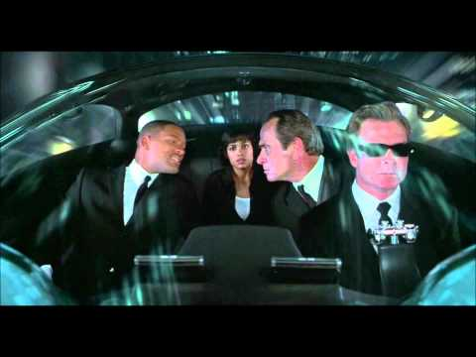
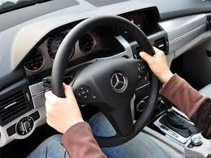
Wat is i18n?
Examples:
Car: Accelerator, wheel…
Men in Black II "What is a Gameboy"
https://www.youtube.com/watch?v=lDtwTqBwqwk&t=1m5s

Slide 4
Wat is i18n?
Examples:
Car: Accelerator, wheel…
Men in Black II "What is a Gameboy"
https://www.youtube.com/watch?v=lDtwTqBwqwk&t=1m5s

Slide 5
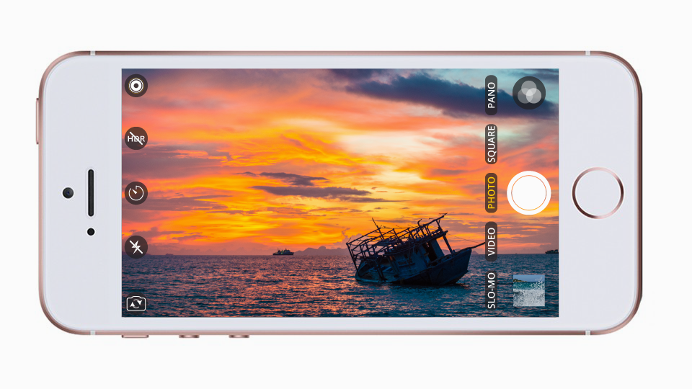
Wat is i18n?
Examples:
Sofware: Mobile phone camera.

Slide 6
Wat is l10n?
l10n: Localization
Make an application localized; that is, work for a given local and concrete context, adapted to the user. https://wiki.mageia.org/en/What_is_i18n,_what_is_l10n
Different application for different country?

Slide 7
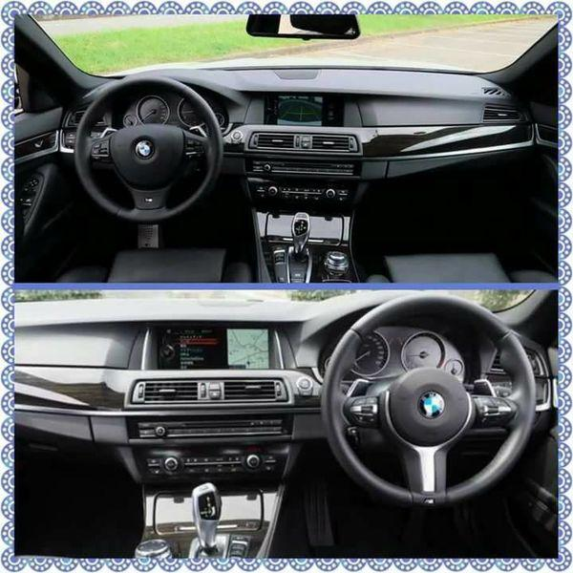
Wat is l10n?
Examples:
Car: Location of the wheel. Left or Right?

Slide 8
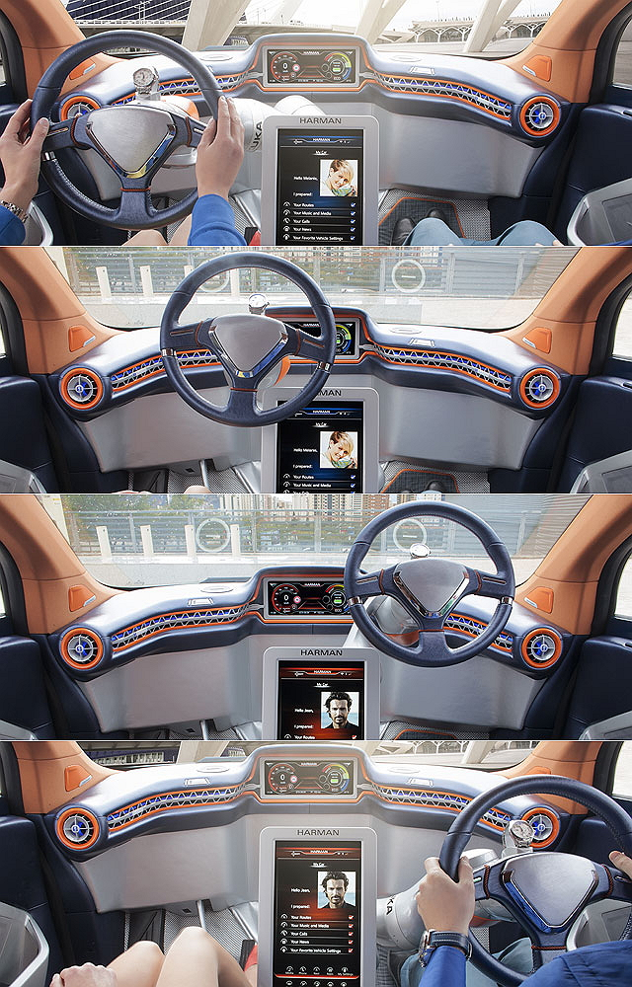
i18n

Slide 9
Wat is l10n?
Examples:
Sofware: Disallow to disable japan mobile phone’s camera shutter sound. https://www.engadget.com/2016/09/30/japans-noisy-iphone-problem/

Slide 10
Basic Guidelines
Not only design for English/native language but also include other languages/cultures.
Layout.
Color/Font-family
Functionality.
Encoding/Character set: Unicode.
Structure of the program.
Test plane.
No hardcoded.
Extract all l10n target out of the source code, and put them into l10n resource folder/files.
Keep sentence complete and meaningful.
Do not split sentence.

Slide 11
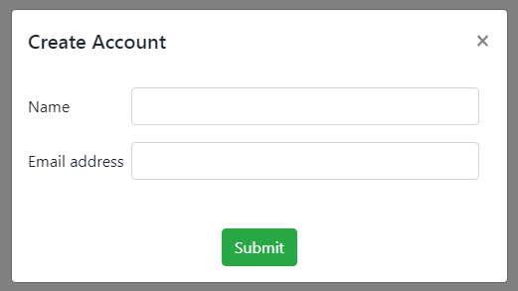
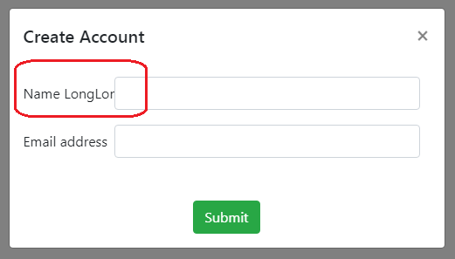
Basic Guidelines
Not only design for English/native language but also include other languages/cultures.
Layout.
Allow extra space for translations...

Slide 12
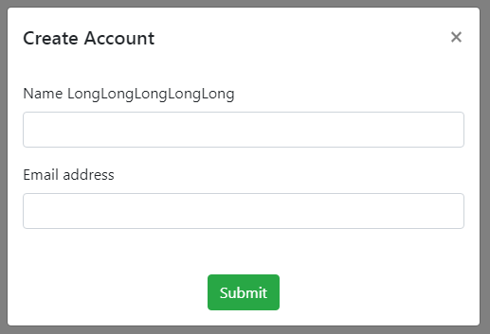
Basic Guidelines
Not only design for English/native language but also include other languages/cultures.
Layout.
Allow extra space for translations...

Slide 13
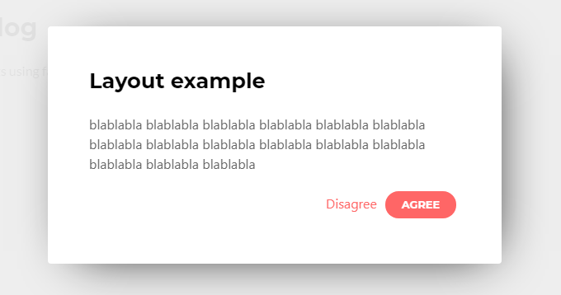
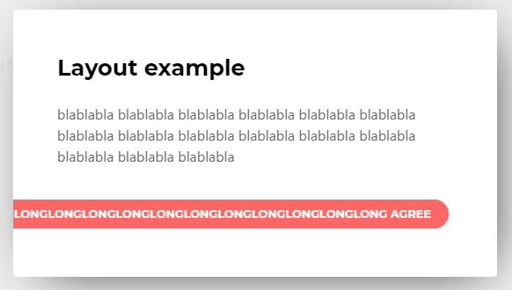
Basic Guidelines
Not only design for English/native language but also include other languages/cultures.
Layout.
Allow extra space for translations...

Slide 14
Basic Guidelines
Not only design for English/native language but also include other languages/cultures.
Color/Font-family
What is it mean to you?
An white envelope with money inside.
The meaning is different between Taiwan and Japan
http://www.merit-times.com.tw/NewsPage.aspx?unid=73583

Slide 15
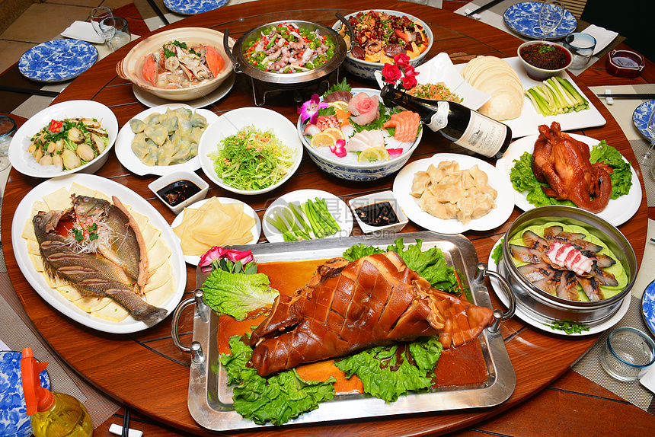
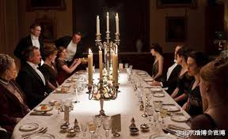
Basic Guidelines
Not only design for English/native language but also include other languages/cultures.
Functionality.

Slide 16
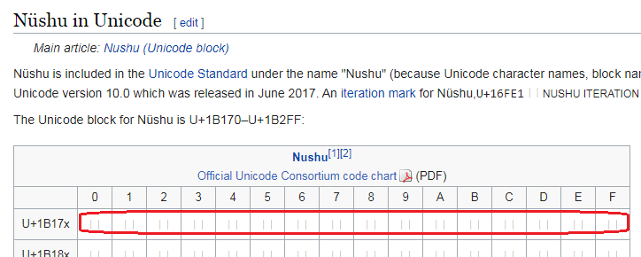
Basic Guidelines
Not only design for English/native language but also include other languages/cultures.
Encoding/Character set: Unicode.
But…
https://en.wikipedia.org/wiki/N%C3%BCshu

Slide 17
Basic Guidelines
Keep sentence complete and meaningful. Do not split sentence.
Bad: Split the sentence.
"Hi " + "Wade" + ", are you ready to race?"
L10N resource
{ "001": "Hi ", "002": "Internationalization (i18n) and localization (L10n)", "003": "Internationalization is the process of designing a software application", "004": "Not only picking i18n framework & apply it to front-end codebase", "005": "technical requirements", "006": ", are you ready to race?", }

Slide 18
Basic Guidelines
Make sentence complete and meaningful. Do not split sentence.
Better: Keep the sentence complete, and apply variable.
"Hi ${plarName}, are you ready to race?"
L10N resource
{ "001": "Hi ${plarName}, are you ready to race?", "002": "Internationalization (i18n) and localization (L10n)", "003": "Internationalization is the process of designing a software application", "004": "Not only picking i18n framework & apply it to front-end codebase", "005": "technical requirements", }

Slide 19
Basic Guidelines
Keep sentence complete and meaningful.
Question | Answer
What kinds of games does Alice play?
What kinds of drinks does Alice want?
What kinds of movies does Alice like?
What kinds of dogs does Alice have?

Slide 20
Basic Guidelines
Make it as template?
A | B
UserName = Alice; Data = [ { 0: game, 1: play }, { 0: drinks, 1: want }, { 0: movies, 1: like }, { 0: dogs, 1: have }, ]; Loop in Data: output: What kinds of {0} does ${UserName} {1}? | UserName = Alice; Data = [ { 0: What kinds of games does ${UserName} play? }, { 0: What kinds of drinks does ${UserName} want? }, { 0: What kinds of movies does ${UserName} like? }, { 0: What kinds of dogs does ${UserName} have? }, ]; Loop in Data: output {0}

Slide 21
Basic Guidelines
Make it as template?
English
What kinds of games does Alice play? | アリスはどのようなゲームをプレイしますか？
What kinds of drinks does Alice want? | アリスはどんな飲み物が欲しいですか？
What kinds of movies does Alice like? | アリスはどんな映画が好きですか？
What kinds of dogs does Alice have? | アリスにはどんな犬がいますか？

Slide 22
Basic Guidelines
L10n resource is NOT template between different sentences.
Grammar matters
Leave grammer in l10n resource, and let translator handle it.

Slide 23
Basic Guidelines
Not only design for English/native language but also include other languages/cultures.
Layout.
Color/Font-family
Functionality.
Encoding/Character set: Unicode.
Structure of the program.
Test plane.
No hardcoded.
Extract all l10n target out of the source code, and put them into l10n resource folder/files.
Keep sentence complete and meaningful.
Do not split sentence.

Slide 24
What needs to be localized?
All displayable words.

Slide 25
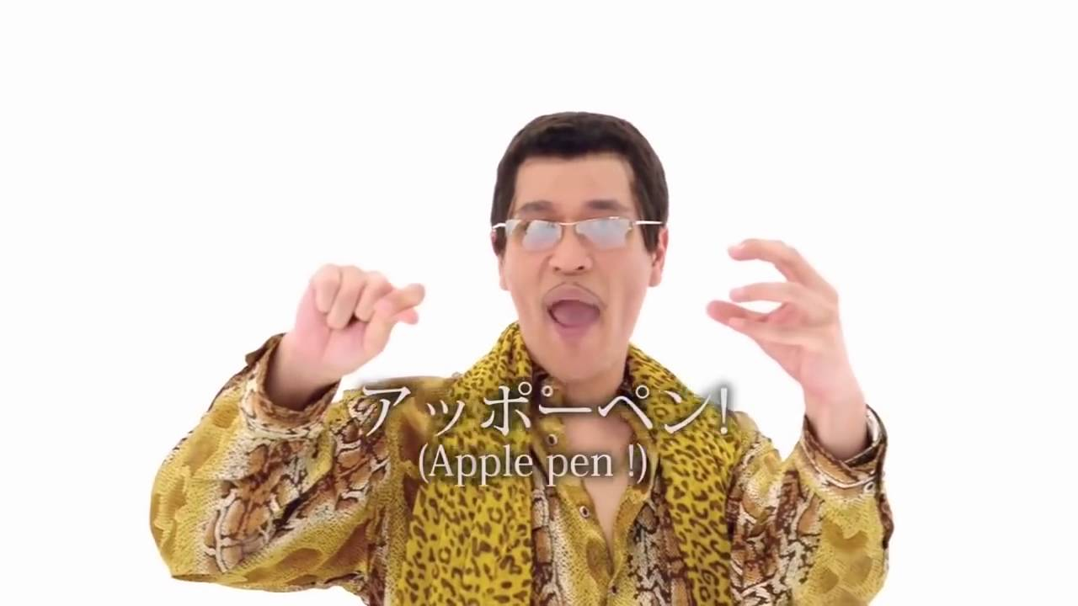
What needs to be localized?
Punctuation.
Comma, Period, Ellipsis, Parentheses...
English: I have a pen, I have an apple. Chinese: 我有一枝筆，我有一顆蘋果。
Symbols and Signs.
Percent sign, ...
English: 40% chance of rain for Ohio State-Nebraska game
Turkish: Ohio State-Nebraska oyunu için% 40 yağmur ihtimali

Slide 26
What needs to be localized?
Date/Time.
09/06/2019
What date?
USA (mm/dd/yyyy): September 6
France (dd/mm/yyyy): June 9
Format matters
https://en.wikipedia.org/wiki/Date_format_by_country

Slide 27
What needs to be localized?
Date/Time.
ISO-8601: 2019-04-05
Taiwan: 民國 108 年 4月 5 日
Japan: 平成 31 年 4 月 5 日
USA: April 5, 2019

Slide 28
What needs to be localized?
Date/Time.
Timestamp: 1569574800
Taiwan (UTC+8): 17:00
Japan (UTC+9): 18:00
Timezone matters

Slide 29
What needs to be localized?
Numbers with symbols.
12,345
How much?
USA : 12 thousands
France: 12
Format matters
https://en.wikipedia.org/wiki/Decimal_separator#Examples_of_use

Slide 30


What needs to be localized?
Images with wording in it.

Slide 31
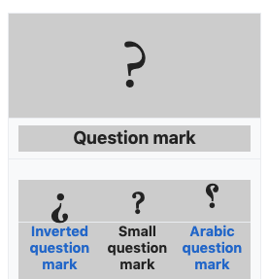

What needs to be localized?
Icon (Sometimes).
Question mark

Slide 32
What needs to be localized?
All displayable sentences.
Punctuation, Symbols and Signs.
Date/Time.
Format (yyyy/mm/dd)
Timezone (UTC+8)
Numbers with symbols.
Decimal point/comma
Thousands Separators
Images with wording in it.
Icons (Sometimes).
Question mark

Slide 33
What does NOT need to be put into l10n resource?
Source code.
Original: To lean more, please check <a here='https://example.com/'>Online help</a>.
Suggest: To lean more, please check ${linkOnlineHelp}.

Slide 34
What does NOT need to be put into l10n resource?
Spical token used by our program.
Original: Use * to represent any series of characters.
We don’t want it become: 使用 ＊ 符號代表任意字元。
(Note: * is not ＊)
Suggest: Use ${tokenAsterisk} to represent any series of characters.

Slide 35
What does NOT need to be put into l10n resource?
Dynamic content.
Original: Disk usage: 80%
We cannot list them all.
Suggest: Disk usage: ${number}%

Slide 36
What does NOT need to be put into l10n resource?
Source code.
To lean more, please check <a here='https://example.com/'>Online help</a>.
Spical token.
Use * to represent any series of characters.
Dynamic content.
Disk usage: 80%

Slide 37
Basic Guidelines
Design with i18n and l10n.
All displayable Text, Date/Time, Numbers, Punctuation, Symbols, Signs, Images and Icons (Some cases).
Keep sentence complete and meaningful.
L10n resource is NOT template between different sentences.
Do not include no-need-translate element into the l10n resource.
Source code.
Spical token.

Slide 38
Q&A

Slide 39
Reference
[1] https://wiki.mageia.org/en/What_is_i18n,_what_is_l10n [2] https://blog.mozilla.org/l10n/2011/12/14/i18n-vs-l10n-whats-the-diff/ [3] https://www.w3.org/International/questions/qa-i18n [4] https://developer.mozilla.org/en-US/docs/Mozilla/Localization/Localization_content_best_practices [5] https://www.infragistics.com/community/blogs/b/devtoolsguy/posts/l10n-and-i18n-best-practices [6] https://en.wikipedia.org/wiki/Percent_sign [7] https://en.wikipedia.org/wiki/Date_format_by_country [8] https://en.wikipedia.org/wiki/Decimal_separator#Examples_of_use | [9] https://www.engadget.com/2016/09/30/japans-noisy-iphone-problem/ [10] https://www.infragistics.com/community/blogs/b/devtoolsguy/posts/introduction-to-localization-and-internationalization [11] https://www.infragistics.com/community/blogs/b/devtoolsguy/posts/l10n-and-i18n-best-practices

